Slide 1
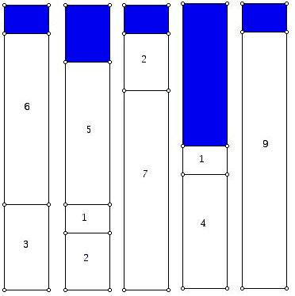
The Bin Packing Problem

Slide 2
Problem Definition
The Bin-Packing Problem (BPP) can be described as follows:
Given m items and n bins, with:
w_{i} = weight of item i
- assume all weights are positive
c =capacity of each bin
- assume capacity is positive and the same for each bin
Assign each item to a bin such that:
the total weight of the items in each bin does not exceed c, and
the number of bins used is a minimum
Source: http://www.ams.org/publicoutreach/feature-column/fcarc-bins2

Slide 3
Develop your own algorithm or approach to solve it
Work in groups
Take around 10-15 minutes
You may want to use Example 1 on handout
Do the best you can – your algorithm may be what you use on the bin packing homework and/or quiz
** Also try to develop a formula to estimate a lower bound on the number of bins needed, irrespective of your algorithm. **

Slide 4
A Student Group Algorithm
sort items in decreasing size order
open one bin
start at front of list, put item in bin if possible, otherwise put item in new bin
next choose item from bak of list, put item in possible, otherwise put item in new bin
go step 3
Notes:
old: – “First Fit”
Pick up a package
If it fits in bin A put it in there
else put it in next bin with room
3. Repeat until no more packages

Slide 5
Another Student Group Algorithm
sort items in descreasing size order
open first bin
put largest item in list in the bin
next put largest item that will fit into that bin
when bin is full open new bin
go to step 3
Notes:
old:
– ‘First Fit
Sort packages in decreasing size order
Start with next package
If next package fits in 1st bin put it there
Else put it in next bin
4. Go to step 2
Decreasing”

Slide 6
Some Heuristic Algorithms to Solve the BPP
First Fit
  Place next item in lowest numbered bin in which it fits
  If item does not fit in any open bin, start a new bin.
First Fit Decreasing
  Same as First Fit except pre-sort the items by decreasing weight
Best Fit
  Place next item into the bin that leaves the least room left over
  If item does not fit in any open bin, start a new bin.

Slide 7
Heuristics applied to an example
Let’s do Example 1 on handout, see white board

Slide 8

What are Heuristic Methods?
Solution methods guided by common sense, intuition, problem structure and/or trial and error
Achieve good but probably not optimal solution
Useful because many models are too large or too complex to be solved to optimality, or may not be solvable in a reasonable amount of time
Some are “quick and dirty” others are very sophisticated
Problems with successful heuristics:
  Traveling salesman problem
  Knapsack problem
  Shortest paths problem
Your HW reading will have more about these
Based in part on Practical Management Science by Winston and Albright

Slide 9
Heuristic Methods: Measures of Performance
Several approaches exist to rate and compare performance of heuristics.
We’ll focus on a few here. See your Heuristics reading for more.
Worst case analysis
Lower bound
Time complexity

Slide 10
Heuristic Method Measures of Performance:
1. Worst Case Analysis (of algorithm)
Let OPT = # of bins used in the optimal solution
Let B = # of bins used in heuristic solution
First Fit algorithm will find a solution that satisfies: B ≤ 2*OPT
Proof
See whiteboard
In fact, a tighter bound can be found. See Salhi reading p14 for more.
Notes:
See Wikipedia article print-out with notes for proof

Slide 11
Heuristic Method Measures of Performance:
2. Lower Bound (of problem)
What did you group come up with for a simple lower bound on BPP solutions?
Min # of bins = total weight of items / bin capacity
Ex 1 on handout: this is 21 / 7 = 3 bins is the lower bound

Slide 12
Heuristic Method Measures of Performance:
3. Time Complexity (of algorithm)
Our old friend from Algorithms (and NANO and Discrete)…
First Fit Decreasing has complexity O(n log n)
You may investigate this somewhat in HW 3
Notes:
See Wikipedia article print-out with notes for proof

Slide 13
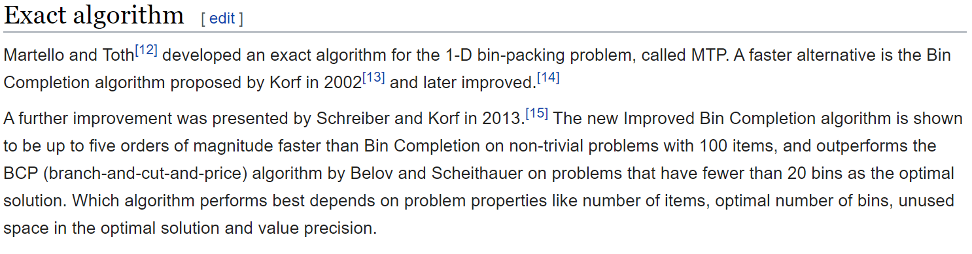
Exact Algorithms
Exact algorithms are guaranteed to find an optimal solution.
The IP formulation of BPP is exact but has weak measures of performance.
For better performance, do some research…
Source: https://en.wikipedia.org/wiki/Bin_packing_problem#Exact_algorithm

Slide 14
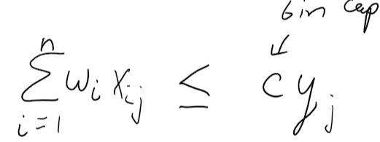
BPP can be formulated as an IP
See white board
How bin constraint works:
Is bin j used? constraint LHS y_{j} = 0 or 1?
  Yes > 0 must be 1
  (an x_{ij} is 1)
  No = 0 could be 0 or 1
  (all x_{ij}’s are 0) objective will ensure y_{j} = 0

